Slide 1
M03 - Requirements Presentation
Team FEED DEAD BEEF

Slide 2
Scope
Our system will be comprised of two main pieces, the cache, and the scratchpad. The purpose for cache is that it is memory that can be accessed quicker than RAM and can store frequently reference information to increase the overall performance of the system. The one downside of cache though is that the data might not always be there, and the data request can miss and not be captured in one clock cycle; this is where the scratchpad comes in handy. Unlike cache, the scratchpad is managed in mostly software and is guaranteed to have a data access time of one clock cycle with no misses. Our system will incorporate these two different memory management systems together in a simulator and have it be a multithreaded application.

Slide 3
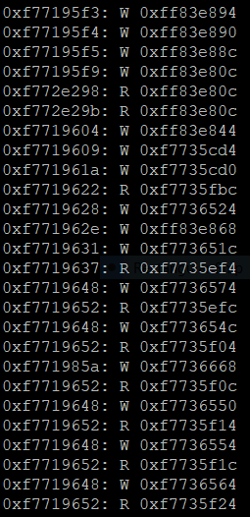
Constraints and Attributes
Will consist of a scratchpad and cache simulator
Will run on at least two cores
The data, read/write identifier, and the address will be inputted into the simulator using a .txt file
The simulator will have a core lock to make sure that an address is not being accessed by multiple cores

Slide 4
Qualitative Attributes
The utility will be used by a command line interface.
The utility will use a predefined file.
The command line interface will display statistics based on analysis of the predefined file.

Slide 5
Quantitative Attributes
The utility will simulate a two core system.
Each simulated core will be given full access to the information within the predefined file.
Each core will be given a user defined portion of the predefined file represented as a percent.
Each core’s statistics for memory hits and misses will be listed in a log file.

Slide 6
Verification
The testing methods for the system are based on the contents of the input file used for simulation. This input file will contain sets of data values with a corresponding command (read or write) and a destination address.
This information will be pushed through the scratchpad/cache simulator and processed. The results of the simulation will verify the success rate of the simulator. The number of commands that are correctly executed as well as the number of failures will be recorded. This will accurately measure the success rate of the simulator.
The average processing times per core will also be recorded. This will allow us to see how fast data is being processed so we can optimize the code as needed for maximum efficiency. This process will be repeated for both the cache and scratchpad portions of the system.

Slide 7
References
“Cache-Simulator”, Author: Ananth Rao, 4/9/15, https://github.com/ananthamapod/Cache-Simulator
“What is the difference between scratchpad and cache memories”, Author: Shane Ryoo, 7/24/2015, https://www.quora.com/What-is-the-difference-between-scratchpad-and-cache-memories
“Scratchpad memory vs Caches - Performance and Predictability comparison”, Author: David Langguth, https://es.cs.uni-kl.de/publications/data/Lang15.pdf

